Slide 1
Network Architecture, Cooperation and Punishment in Public Good Experiments
Jeffrey Carpenter Shachar Kariv Andrew Schotter
Review of Economic Design (2010)
Special Issue in Honor of Leonid Hurwicz

Slide 2
Motivation
Can self interested individuals cooperate to achieve socially efficient outcomes?
Typical public goods experiments find provision to be low
Fehr and Gachter (2000): If contributions can be monitored and those not contributing punishable, provision is high!
This strand of literature assumes full monitoring

Slide 3
Motivation
In practice, individuals are bound by a social network
⇒ Monitoring can only be partial!
Questions
Can partial monitoring restore cooperation?
Does the network structure matter?
If so, how in terms of provision, punishment and efficiency?

Slide 4
Networks
8 different 4 person networks
3 global properties: completeness, connectedness and directedness
1 local property of the neighborhoods defining the graph: degree

Slide 5
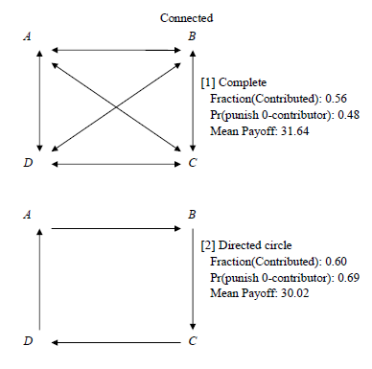
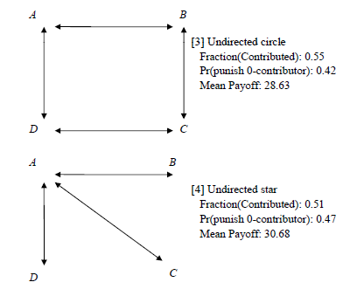
Networks: 1 - 4

Slide 6
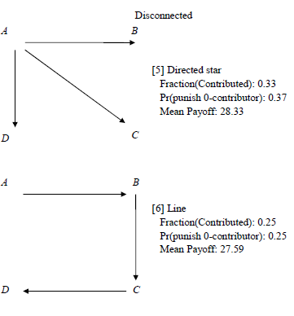
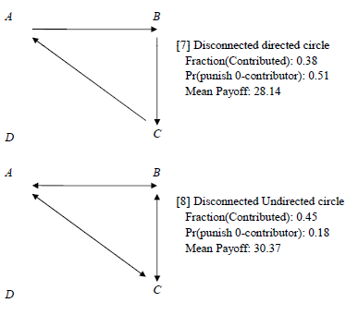
Networks: 5 - 8

Slide 7
Networks
Network [1] is complete, the others are not
Networks [1]-[4] are connected and the others are not. In networks [7]-[8] there is connectedness within the subgraph
Networks [2] and [5]-[7] are directed and the others are not

Slide 8
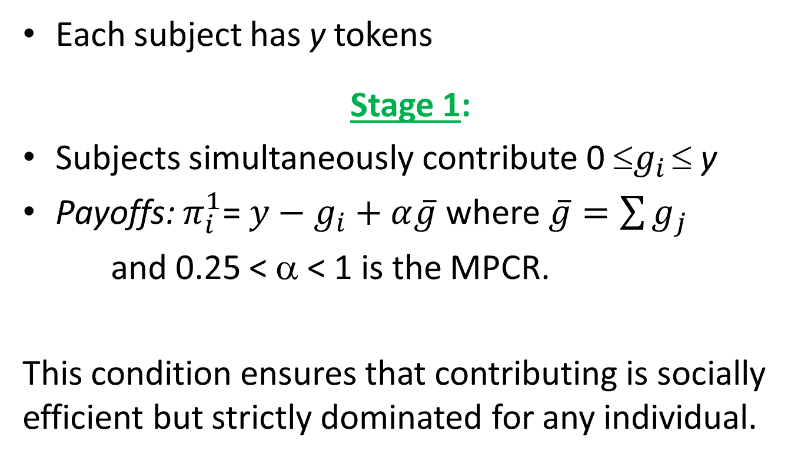
Public goods game
Each subject has y tokens
Stage 1:
Subjects simultaneously contribute 0 ≤$g_{i}$ ≤ y
Payoffs: $π_{i}^{1}$= $y−g_{i}+α\overline{g}$ where $\overline{g}=\sum{g_{j}}$
and 0.25 < α < 1 is the MPCR.
This condition ensures that contributing is socially efficient but strictly dominated for any individual.

Slide 9
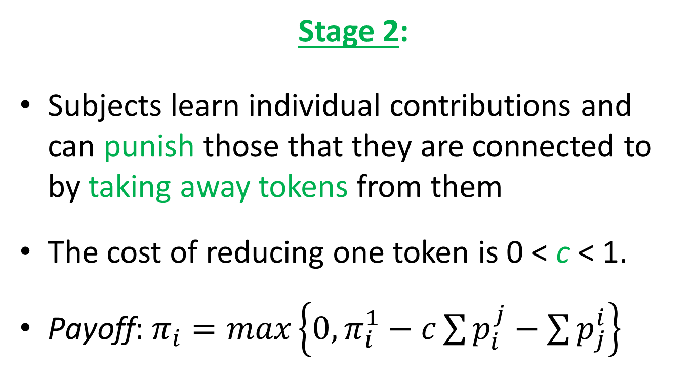
Public goods game
Stage 2:
Subjects learn individual contributions and can punish those that they are connected to by taking away tokens from them
The cost of reducing one token is 0 < c < 1.
Payoff: $π_{i}=max\left\{0,π_{i}^{1}−c\sum{p_{i}^{j}}−\sum{p_{j}^{i}}\right\}$

Slide 10
Public goods game
Punishment cannot deter free-riding under any networks architecture.
This follows by Backward Induction.

Slide 11
Experiment
Done at NYU and UC Berkeley
Undergraduate students with no prior experience in these types of experiments
y = 25; α = 0.4 and c = 0.5.
Participation fee = $5
Each session had 15 rounds and the network was held constant in each session
Same was true for subject type (A, B, C, D)

Slide 12
Experiment
In each round the 4 person network was formed randomly by drawing one person from each of the 4 types
At the end of Stage 1, subjects knew the contributions of the persons they were connected to and total group contribution
At the end of Stage 2 they knew their total payoff net of all punishment decisions

Slide 13
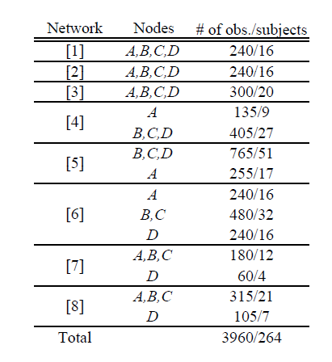
Experimental design

Slide 14
Questions
Completeness: Compare [1] to the undirected circle [3] and undirected star [4]. The last 2 are both connected and undirected, but incomplete.
Connectedness: Compare directed circle [2] to line [6], because removing one link makes the circle disconnected. Compare [2] to disconnected directed circle [7] and undirected circle [3] to disconnected undirected circle [8].

Slide 15
Networks: 1-4

Slide 16
Networks: 5-8

Slide 17
Questions
Directedness: Compare directed and undirected circles [2] and [3] and stars [5] and [4]. Compare disconnected directed and undirected circles [7] and [8].
Degree: Test whether subjects who have same in-degree and out-degree behave differently in different networks

Slide 18
Results: Contributions
There is a great deal of variation in contribution depending on the network
Connected networks within which everyone is monitored have significantly higher contributions (5 tokens more or 20% more) than disconnected networks.
Complete network no different from other connected networks.
No difference in other properties

Slide 19
Results: Punishment
More punishment is used to maintain or increase contributions in directed networks
Completeness and directedness play a role in punishment: In the complete network where policing free-riding is decentralized, sanctions are low. In the directed network, where only one person must sanction, they are high.
Punishing involves coordination issues.

Slide 20
Results: Efficiency
Connected networks are the most efficient while disconnected networks are the least.
Adding or removing edges does not necessarily increase or decrease efficiency.
Complete network is better for efficiency since it introduces the possibility of free rd==iding in punishment.

Slide 21
Results: Summing up
“Optimal” number of edges in this game?
Based on the results and using efficiency as a criteria, 1-4 edges are good (too few edges), same for 9-12 edges. 5-8 edges is not good (too much punishment relative to contributions).
Take away:
Network architecture matters for behavior and outcomes in public goods experiments. Connectedness is particularly important for desirable outcomes.

Slide 22
Thank you

